Slide 1
IEDA4331 CRYPTO OPTIONS
Pricing, Greeks, and Jump-Risk Management for BTC/ETH Vanilla Options
Authors
Choi Man Hou
SID: 20894196
mhchoiaf@connect.ust.hk
Thesis: crypto options need a model stack, not a single winner.
Lee Cheuk Yiu
SID: 21051040
cyleebt@connect.ust.hk
We compare Black-Scholes, CRR, Merton, SVCJ, MR-ISVM, Dynamic Jump, and GARCH across pricing accuracy, crash protection, Greeks, and hedging error.
QUESTION 1
QUESTION 2
QUESTION 3
Mark
Crash
Hedge
Main deck capped at 15 slides
Which model is closest to Deribit option prices?
Which model pays most for downside insurance?
Which model leaves the smallest hedge residual?
Project output deck | Course motivation: risk-neutral pricing, BSM, CRR, Greeks, hedging
01

Slide 2
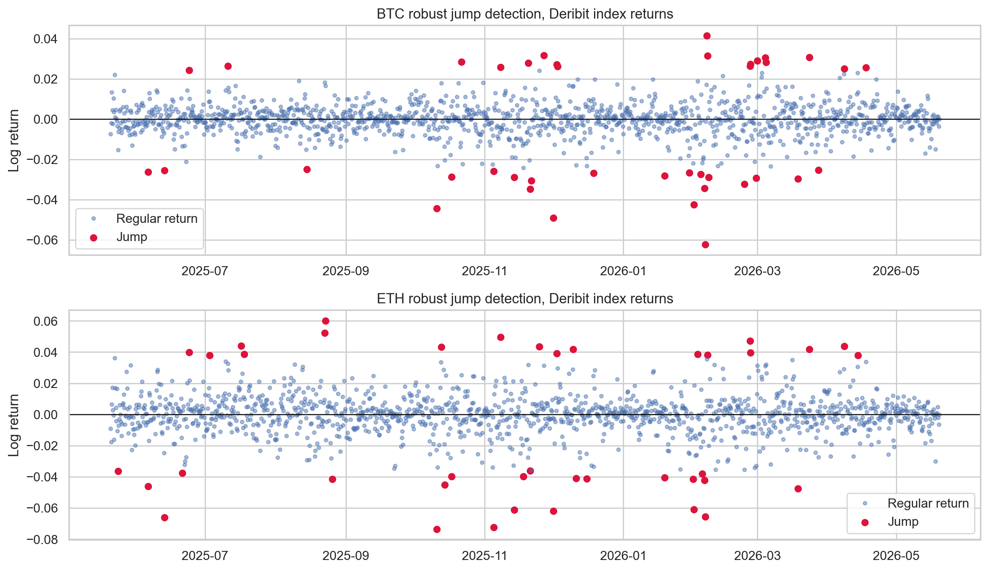
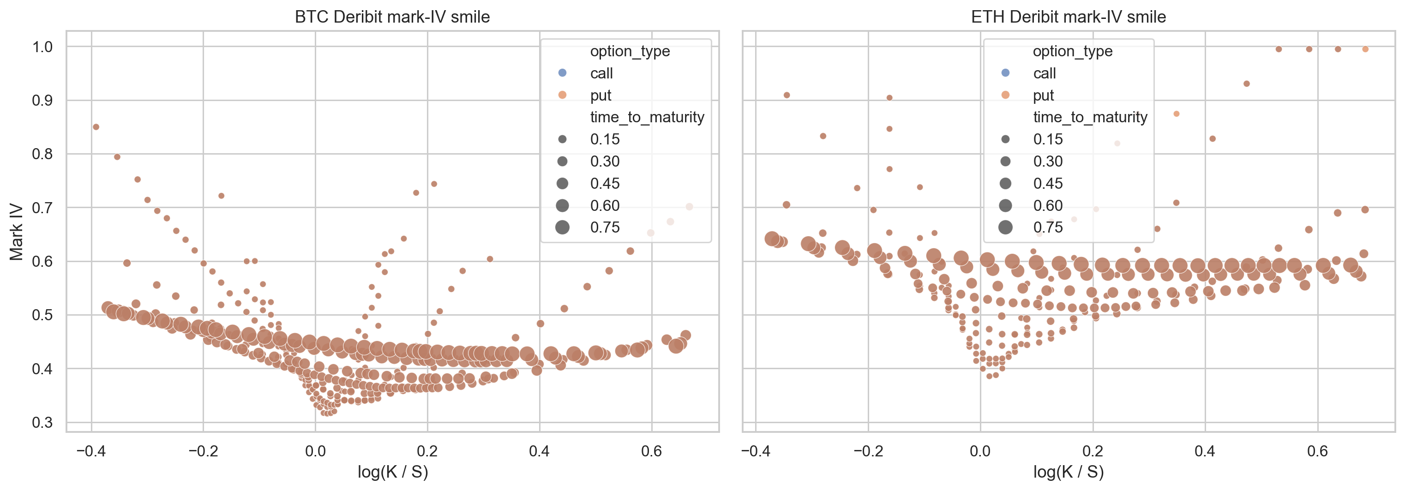
EMPIRICAL MOTIVATION
The classroom diffusion breaks first in crypto tails and smiles.
BSM assumes continuous paths and constant volatility. BTC/ETH data show jumps, heavy tails, and a non-flat implied-volatility smile.
TAIL EVIDENCE
Jump days are visible discontinuities: the exact event BSM cannot generate.
SMILE EVIDENCE
Different strikes imply different volatilities: one constant sigma is too rigid.
Course bridge: BSM is the control case; the project asks what extra state variable or jump mechanism is needed for crypto.
Sources: Deribit 1-year BTC/ETH index history and live option-chain snapshot from project pipeline; Black and Scholes (1973).
02

Slide 3
EVALUATION PROTOCOL
We judge models by three desk questions, not by formula elegance.
A model can mark options well, but still underprice crash insurance or hedge poorly when jumps arrive.
MARKING ERROR
ACCURACY
IMPROVEMENT
e_i^(m) = Vhat_i^(m) - V_i^mkt
MAE = mean(|e_i|), RMSE = sqrt(mean(e_i^2))
Delta AE_i = |e_i^BS| - |e_i^m|
Signed error shows whether model m overprices or underprices the observed Deribit option.
MAE is robust and easy to read; RMSE penalizes large misses more heavily.
Positive values mean the candidate improves on Black-Scholes for that option.
Desk question
Metric
Course link
Interpretation
Mark
MAE / RMSE / bias
pricing and calibration
Can we quote close to market?
Crash
5% OTM put value
risk-neutral tail payoff
How much downside insurance is priced?
Hedge
mean absolute P&L
Delta hedging and Greeks
How much residual risk remains?
Plain-English reading: lower MAE is better for marking; higher stressed put value is more conservative for crash protection; lower hedge P&L magnitude is better for hedging.
Sources: project report metrics and generated candidate comparison tables.
03

Slide 4
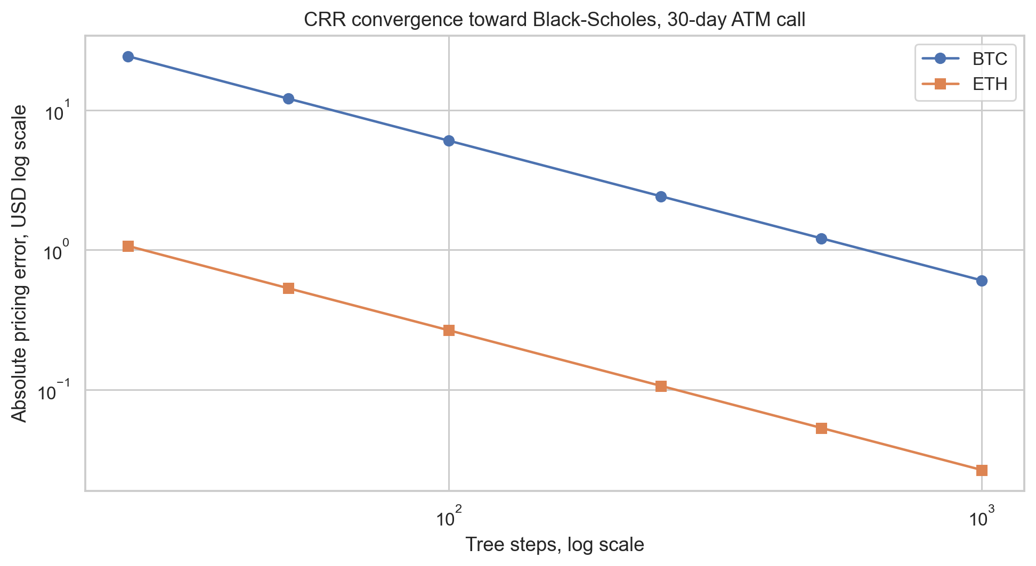
BASELINE CONTROLS
BSM and CRR anchor no-arbitrage logic before we add crypto risk channels.
The baselines are not weak strawmen. They are the course-consistent controls that every extension must beat.
BLACK-SCHOLES-MERTON
C = S N(d1) - K exp(-rT) N(d2)
Continuous diffusion, lognormal terminal price, constant volatility, and dynamic Delta hedging.
CRR BINOMIAL TREE
V = exp(-r dt) [p V_u + (1-p) V_d]
Discrete risk-neutral replication. As the tree becomes fine, the European price converges toward BSM.
The convergence plot is a sanity check: our numerical tree is aligned with the closed-form benchmark before we compare richer crypto models.
Course extension: after the no-arbitrage benchmark is verified, deviations are interpreted as distributional model risk, not implementation noise.
Sources: Cox, Ross, and Rubinstein (1979); Black and Scholes (1973); project CRR convergence test.
04

Slide 5
MODEL STACK
Each candidate repairs a different missing crypto risk channel.
The comparison is deliberately multi-objective: pricing, stress, Greeks, and hedge performance can choose different winners.
Black-Scholes
Merton
SVCJ proxy
Smooth diffusion baseline
Random price jumps
Spot-volatility co-jumps
Best for course intuition and put-call logic, but too rigid for jumps and smiles.
Adds crash arrivals to BSM and creates explicit tail-risk compensation.
Treats crashes as joint events: price falls while volatility jumps upward.
MR-ISVM surface
Dynamic jump
GARCH variance
Regime-aware IV surface
Clustered jump intensity
Volatility persistence
Lets the market smile itself change by calm, trend, or stress regime.
Lets jump risk arrive in waves instead of using one static lambda.
Explains smiles through clustered volatility rather than explicit price jumps.
Black-Scholes
Merton
SVCJ proxy
Key framing: Merton is a classical benchmark from 1976; the innovation is the full candidate comparison and desk-level model-stack recommendation.
MR-ISVM surface
Dynamic jump
GARCH variance
Sources: Merton (1976); Bates (1996); Venter and Mare (2021); Saef et al. (2022); Chen and Yang (2024).
05

Slide 6
MERTON BENCHMARK
Merton is the first repair: random jumps make tail risk explicit.
For crypto, this is the natural bridge from course BSM to heavy-tailed option pricing.
RISK-NEUTRAL PROCESS
Poisson-mixture pricing intuition
dS/S- = (r - lambda*kappa)dt + sigma dW + (J - 1)dN
The drift is adjusted by lambda*kappa so prices remain risk-neutral after adding jumps.
1
Condition on n jumps
2
Price with adjusted variance and drift
JUMP SIZE
log J ~ Normal(mu_J, delta_J^2)
3
Average across Poisson probabilities
Jump sizes are random and lognormal. The model averages prices over possible jump counts.
Merton improves tail realism, but still assumes constant jump intensity and independent jumps. That is why we test newer candidates beside it.
Comparison thread: Merton should beat BSM on crypto tails, but it may lose to regime or volatility-clustering models in marking and hedging.
Sources: Merton (1976); project Merton jump-diffusion implementation and calibration.
06

Slide 7
MODERN CANDIDATES
Modern candidates test four explanations for the crypto smile.
Merton becomes one reference model inside a broader candidate tournament.
SVCJ proxy
MR-ISVM surface
Dynamic jump
GARCH variance
Stochastic volatility with correlated jumps
Market-regime implied stochastic volatility
Time-varying jump intensity
Generalized autoregressive conditional heteroskedasticity
Plain English: a crypto crash often arrives with a volatility spike. SVCJ prices that joint event.
Plain English: the option smile changes across calm and stress regimes, so implied vol is regime-aware.
Plain English: jump risk is not constant. Stress periods make the next jump more likely.
Plain English: large returns increase future variance, so volatility has memory.
dS jump + dv jump
sigma_IV = f_regime(K,T)
lambda_t mean-reverts and jumps
h_{t+1}=omega+alpha r_t^2+beta h_t
Non-expert shortcut: SVCJ prices crash plus panic, MR-ISVM listens to the option surface, Dynamic Jump lets risk cluster, and GARCH remembers recent volatility shocks.
Sources: Bates (1996); Venter and Mare (2021); Saef et al. (2022); Chen and Yang (2024); project candidate_models.py.
07

Slide 8
PRICING ACCURACY
Pricing accuracy has two winners: Merton for BTC, MR-ISVM for ETH.
The same model does not dominate both underlyings, which is already a model-risk result.
BTC MAE, USD lower is better
ETH MAE, USD lower is better
Merton
$230
BEST
MR-ISVM
$11.3
BEST
SVCJ proxy
$231
Merton
$12.9
Dynamic jump
$268
Dynamic jump
$13.5
MR-ISVM
$368
GARCH
$13.9
GARCH
$626
SVCJ proxy
$30.2
Black-Scholes
$1149
Black-Scholes
$31.0
Underlying
Best candidate
MAE
Interpretation
BTC
Merton
$230
Jump risk improves the heavy-tail mark.
ETH
MR-ISVM surface
$11.3
The current surface shape carries more signal.
Source: reports/tables/candidate_model_errors.csv; Deribit BTC/ETH option snapshot after liquidity and maturity filters. Best = lowest MAE.
08

Slide 9
STATISTICAL INFERENCE
Most candidate improvements are statistically meaningful, but not all are equally useful.
The paired tests ask whether each model reduces absolute error relative to Black-Scholes on the same option contracts.
Asset
Candidate
Share improved
Mean AE gain
t-test p
Evidence
BTC
Dynamic jump
85.8%
$882
< 1e-74
strong
How to read the tests
BTC
Merton
81.5%
$919
< 1e-66
strong
1. Share improved: fraction of contracts where a candidate beats BSM.
2. Paired t-test: asks whether average improvement is positive.
3. Wilcoxon and sign tests: robustness checks that avoid relying only on normality.
BTC
SVCJ proxy
82.3%
$918
< 1e-64
strong
ETH
GARCH variance
85.7%
$17.1
< 1e-47
strong
ETH
MR-ISVM surface
81.0%
$19.7
< 1e-39
strong
ETH
SVCJ proxy
51.3%
$0.8
0.202
weak
Inference is useful because it turns a pretty ranking chart into a testable claim: the improvement is not just visual noise.
Source: reports/tables/candidate_statistical_tests.csv. Paired tests compare each candidate AE against Black-Scholes on identical contracts.
09

Slide 10
RATE SENSITIVITY
Rates move calls and puts as course theory predicts, but model risk dominates the dollar level.
We reprice 30-day ATM options at r = 1% and r = 5% for every candidate.
Model
BTC call
BTC put
ETH call
ETH put
Course intuition
Black-Scholes
+125.3
-127.0
+3.35
-3.59
Higher rates reduce the present value of the strike.
Calls tend to rise.
Puts tend to fall.
The sign is stable across all candidates.
Merton
+133.1
-119.2
+3.47
-3.48
SVCJ proxy
+132.5
-119.8
+3.41
-3.53
MR-ISVM surface
+123.5
-129.6
+3.36
-3.61
Dynamic jump
+132.3
-120.0
+3.45
-3.50
What matters more in crypto is not the sign of rho, but the volatility and jump assumptions used to price the option before rates are shocked.
GARCH variance
+124.1
-128.1
+3.31
-3.63
Comparison thread: all candidates agree on rate direction; they disagree much more on jump, smile, and volatility risk premia.
Source: reports/tables/candidate_rate_summary.csv. 30-day ATM repricing; values are USD price changes from r = 1% to r = 5%.
10

Slide 11
CRASH STRESS
Crash-stress testing changes the ranking: SVCJ carries the highest downside insurance value.
We price a 30-day 5% OTM put under each candidate as a simple downside-protection test.
BTC 30-day 5% OTM put value
ETH 30-day 5% OTM put value
Black-Scholes
$900
Black-Scholes
$58.8
Merton
$2099
Merton
$83.2
SVCJ proxy
$2146
BEST
SVCJ proxy
$92.5
BEST
MR-ISVM
$1963
MR-ISVM
$72.4
Dynamic jump
$1961
Dynamic jump
$82.0
GARCH
$1249
GARCH
$75.5
Underlying
Best crash model
Put value
Economic intuition
BTC
SVCJ proxy
$2,146
Crash plus volatility shock is expensive.
ETH
SVCJ proxy
$92.5
Co-jumps dominate downside insurance.
Source: reports/tables/candidate_stress_prices.csv. Scenario = 30-day 5% OTM put; higher value means more downside insurance.
11

Slide 12
GREEKS
Greeks are local risk measures; jump risk is not local.
Delta, Gamma, Vega, and Rho remain essential, but jump models change what 'local' sensitivity means.
BTC ATM call model
Delta
Gamma
Vega
Interpretation
Black-Scholes
0.520
0.000066
8,790
clean baseline
Course link
Merton
0.570
0.000043
631
jump mixture shifts sensitivity
Delta and Gamma approximate small smooth moves.
A price jump is a discontinuity, so hedge error can be dominated by a move that no local derivative saw coming.
SVCJ proxy
0.568
0.000042
1,686
co-jump stress premium
MR-ISVM surface
0.545
0.008556
8,786
surface curvature can create high local gamma
Dynamic jump
0.564
0.000046
3,561
clustered jump channel
GARCH variance
0.522
0.000056
8,787
volatility persistence
Comparison thread: MR-ISVM can fit surface curvature, Merton and Dynamic Jump change tail exposure, and GARCH keeps diffusion but updates variance.
Source: reports/tables/candidate_greek_summary.csv. Values shown for BTC ATM call at project parameter settings.
12

Slide 13
HEDGING SIMULATION
The best pricing model is not always the best hedge model.
We simulate short-option Delta hedging and compare mean absolute hedge P&L by candidate.
BTC mean absolute hedge P&L, lower is better
ETH mean absolute hedge P&L, lower is better
MR-ISVM
$1210
BEST
GARCH
$28.6
BEST
GARCH
$1222
Black-Scholes
$28.8
Dynamic jump
$1232
MR-ISVM
$30.1
Merton
$1232
Dynamic jump
$31.3
SVCJ proxy
$1252
Merton
$31.9
Black-Scholes
$1330
SVCJ proxy
$36.1
Underlying
Best hedge model
Mean |P&L|
Implication
BTC
MR-ISVM surface
$1,210
Surface-aware Delta is most stable.
ETH
GARCH variance
$28.7
Volatility memory helps hedging.
Desk lesson: choose the model by the job. Marking, stress valuation, and hedging can legitimately point to different candidates.
Source: reports/tables/candidate_hedge_summary.csv. Short-option Delta hedging simulation; lower mean absolute P&L means lower residual hedge error.
13

Slide 14
RECOMMENDATION
Use a model stack: one model for marking, one for crash insurance, one for hedging diagnostics.
This is the professional takeaway from the full candidate comparison.
Desk objective
Recommended model
Why it wins here
How to explain it to a non-expert
BTC marking
Merton
Lowest BTC MAE
Random jumps fix the biggest BSM miss in BTC tails.
ETH marking
MR-ISVM surface
Lowest ETH MAE
The current ETH smile contains useful regime information.
Crash protection
SVCJ proxy
Highest stressed put value
A crash is both a price drop and a volatility shock.
BTC hedge
MR-ISVM surface
Lowest BTC hedge |P&L|
Hedging improves when the surface shape informs Delta.
ETH hedge
GARCH variance
Lowest ETH hedge |P&L|
ETH hedge errors are better captured by volatility persistence.
Final synthesis
BSM and CRR teach the replication logic; the candidate stack teaches where crypto market risk breaks the assumptions.
For a course project, the innovation is not claiming a single exotic model wins. It is showing how model choice changes by risk-management objective.
Sources: project pricing, stress, Greeks, and hedging tables.
14

Slide 15
Final Takeaway
Crypto options are a model-risk problem before they are a formula problem.
The course models give the replication baseline. The project extension shows why real crypto desks need jump-aware pricing, regime-aware surfaces, and hedge-error diagnostics working together.
1. Baseline
2. Innovation
3. Risk view
BSM and CRR remain the no-arbitrage controls.
Modern candidates separate jumps, regimes, and volatility memory.
The best model depends on the desk objective.
Core references
Black and Scholes (1973); Merton (1976); Cox, Ross, and Rubinstein (1979); Bates (1996); Venter and Mare (2021); Saef, Wang, and Aste (2022); Chen and Yang (2024); Jiang (2026), IEDA4331 lecture notes.
Thank you
Closing slide includes references to keep the main presentation within 15 slides total.
15

